Slide 1
[ju:]
Uniform, school uniform, to wear a school uniform
[dʒ]
Language, foreign language, the English language, . to study the language

Slide 2
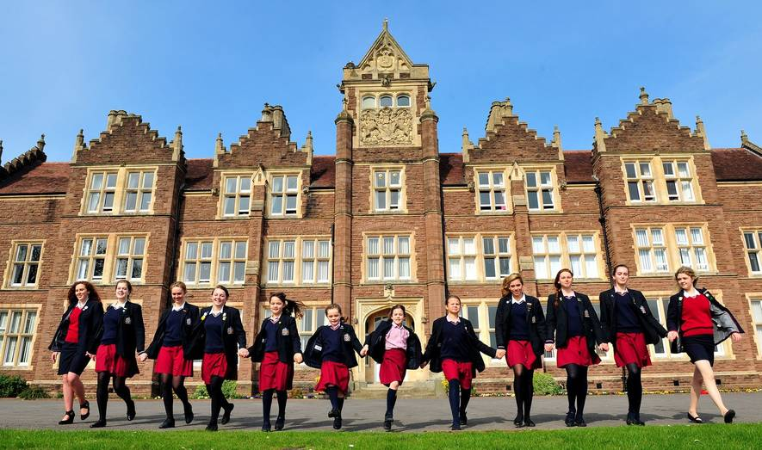
British schools

Slide 3
Write and learn!
Art [ɑːt] – изо (искусство)
Drama [ˈdrɑːmə] – актерское мастерство
Literature [ˈlɪt(ə)rətʃə] – Литература
Maths [mæθs] – математика

Slide 4
Match the subject with the activity.
What do you
do in PE lessons?
I run, play, jump.

Slide 5
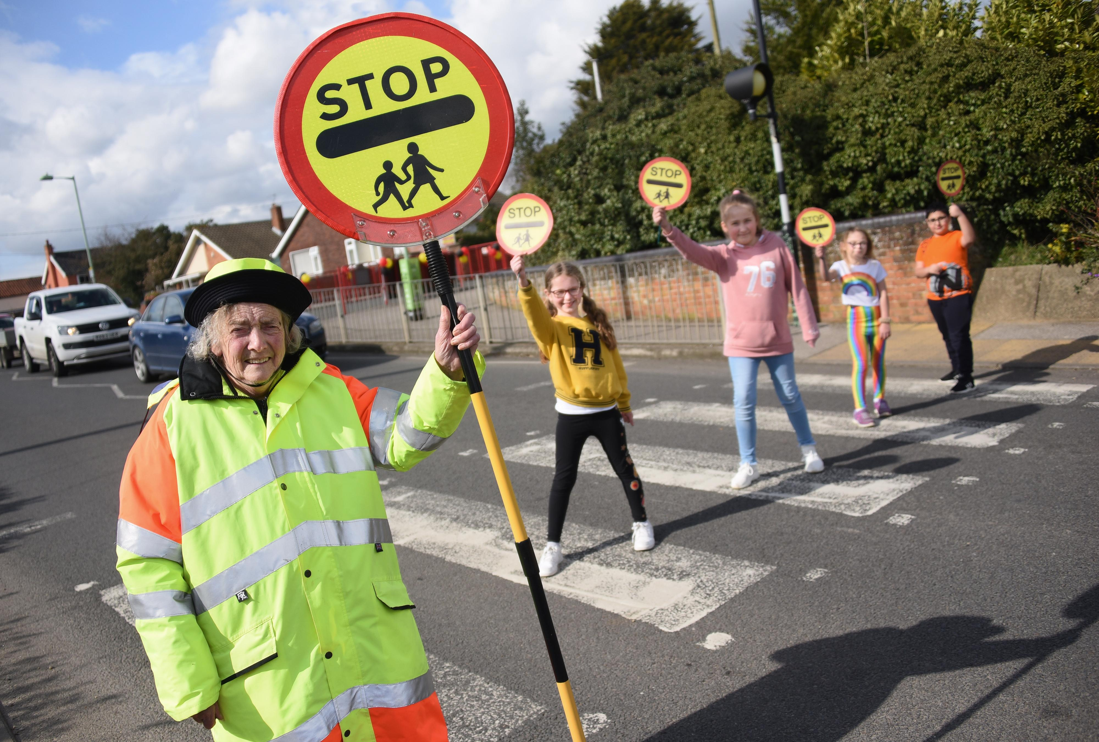
Lollipop Lady

Slide 6
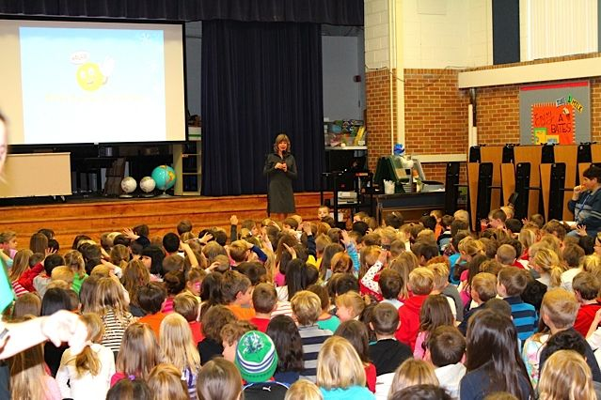
Assembly - meeting

Slide 7
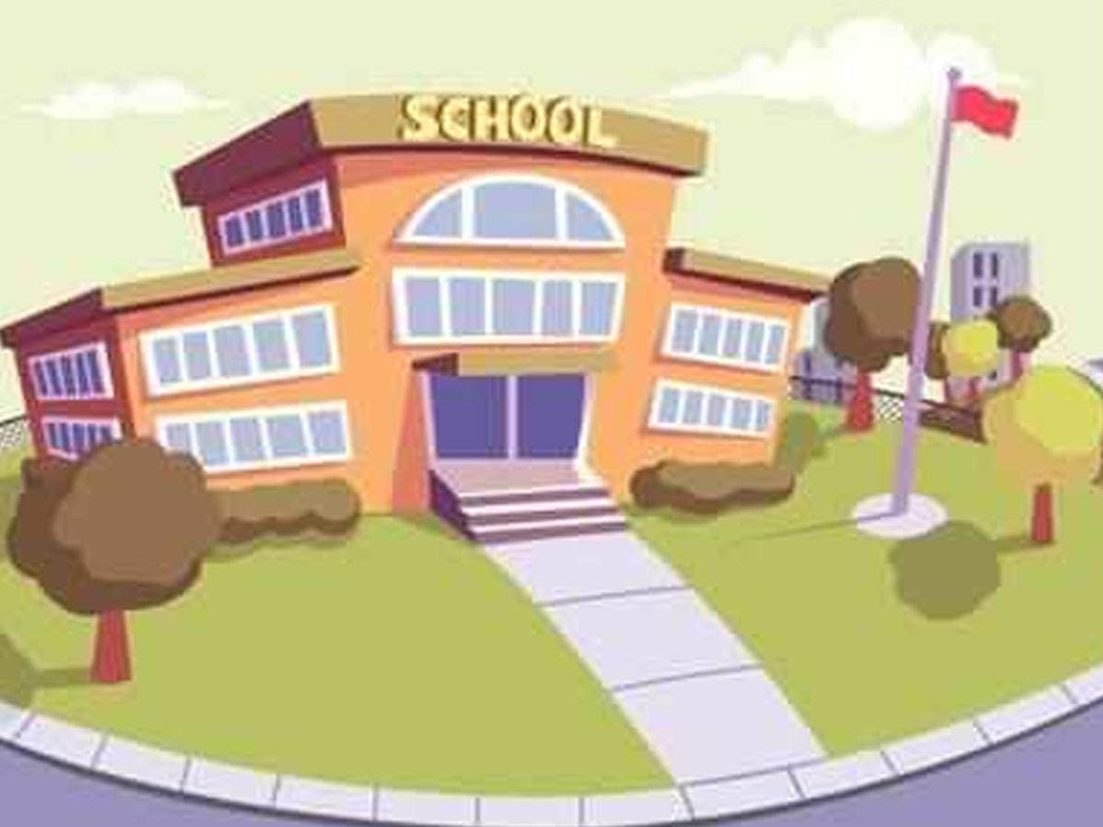
The school starts at… o’clock.
We usually have … lessons.
The breaks last … minutes.

Slide 8
Summing up
Activity | Yes/No
1) I studied new words
2) I used the words in speech
3) I knew some new information about British schools
4) I answered the questions about the video
5) I liked the lesson
6) My mark

